Slide 1
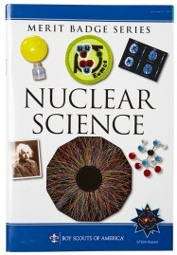
Nuclear Science Merit Badge
Revision 7.1 – 19 Jan 2024

Slide 2
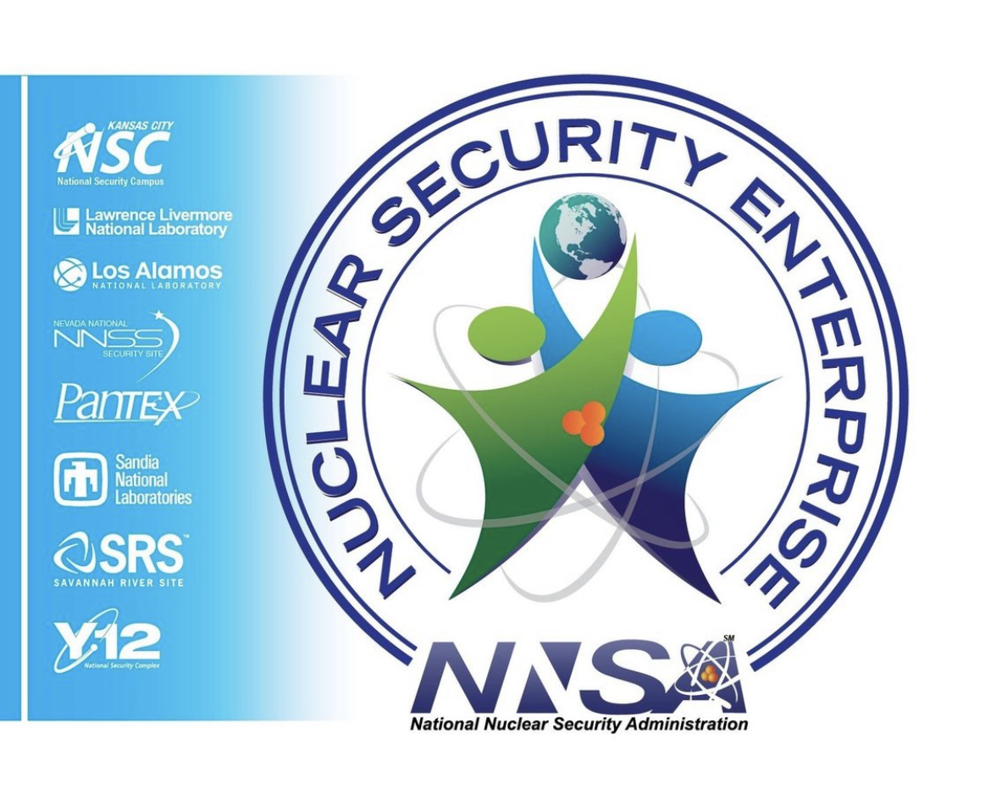
Hello! Welcome to the Nuclear Science Merit Badge course for the 2024 Golden Spread Council’s Merit Badge University at West Texas A&M University – 20 January 2024
William Reeves Easley-McPherson,
U.S. Department of Energy/National Nuclear Security Administration/Pantex Plant Contractor Employee
Emergency Management Specialist
Lead, Emergency Radiation Treatment Facility Team For Pantex Emergency Services.
Radiological Worker II Certification
Eagle Scout class of 1981 Retired Cubmaster and Scoutmaster

Slide 3

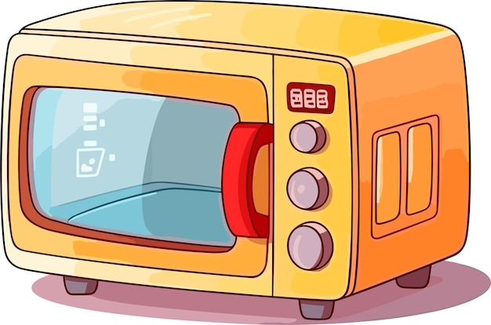
1a. Explain radiation and the difference between ionizing and non-ionizing radiation.
Non-ionizing radiation is a form of radiation with less energy than ionizing radiation. Unlike ionizing radiation, non-ionizing radiation does not remove electrons from atoms or molecules of materials that include air, water, and living tissue. Non-ionizing radiation exists all around us from many sources.
Examples include:
Radiofrequency (RF) radiation used in many broadcast and communications applications. (e.g. Cellular Telephones, Radios, Television, etc.)
Microwaves used in the home kitchen.
Infrared radiation used in heat lamps.
Ultraviolet (UV) radiation from the sun and tanning beds.
The dividing line between ionizing and non-ionizing radiation occurs in the ultraviolet part of the electromagnetic spectrum

Slide 4

1a. Explain radiation and the difference between ionizing and non-ionizing radiation.
Ionizing radiation is a form of energy that acts by removing electrons from atoms and molecules of materials that include air, water, and living tissue. Ionizing radiation can travel unseen and pass through these materials.
A familiar example of ionizing radiation is that of x-rays, which can penetrate our body and reveal pictures of our bones. We say that x-rays are “ionizing,” meaning that they have the unique capability to remove electrons from atoms and molecules in the matter through which they pass. Ionizing activity can alter molecules within the cells of our body. That action may cause eventual harm (such as cancer). Intense exposures to ionizing radiation may produce skin or tissue damage.

Slide 5
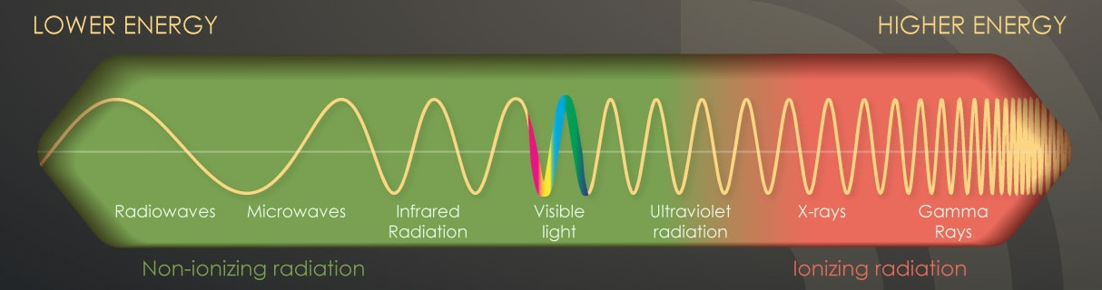
1a. Explain radiation and the difference between ionizing and non-ionizing radiation.
When ionizing radiation passes through material such as air, water, or living tissue, it deposits enough energy to produce ions by breaking molecular bonds and displace (or remove) electrons from atoms or molecules. This electron displacement may lead to changes in living cells. Given this ability, ionizing radiation has a number of beneficial uses, including treating cancer or sterilizing medical equipment.

Slide 6

1b. Explain the ALARA principle and the measures required by law to minimize these risks. Describe what safety
requirements you will need to consider while performing the requirements in this merit badge.
ALARA – As Low As Reasonably Achievable, and is defined as performing one or any combination of the following techniques:
Time
Minimize Time - “Time” simply refers to the amount of time spent near a radioactive source. Minimize time spent near a radioactive source to do only what it takes to get the job done. If within an area where radiation levels are elevated, complete work as quickly as possible and then leave the area. There is no reason to spend more time around it than necessary.

Slide 7
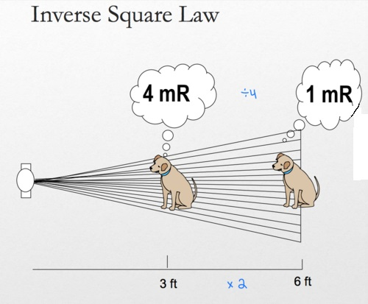
1b. Explain the ALARA principle and the measures required by law to minimize these risks. Describe what safety
requirements you will need to consider while performing the requirements in this merit badge.
ALARA – As Low As Reasonably Achievable, and is defined as performing one or any combination of the following techniques:
Distance
Maximize Distance - “Distance” refers to how close someone is to a radioactive source. Maximize distance from a radioactive source as much as possible. This is an easy way to protect people because distance and dose are inversely related. Dose decreases if distance increases.

Slide 8
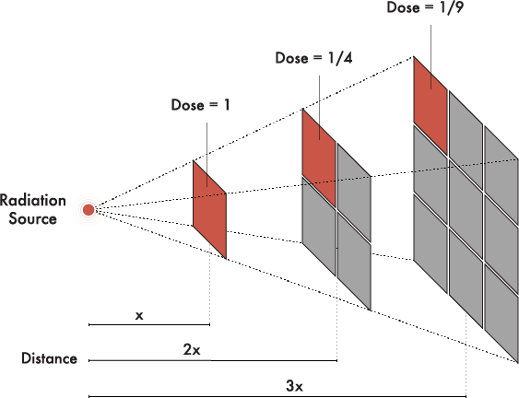
1b. Explain the ALARA principle and the measures required by law to minimize these risks. Describe what safety
requirements you will need to consider while performing the requirements in this merit badge.
ALARA – As Low As Reasonably Achievable

Slide 9
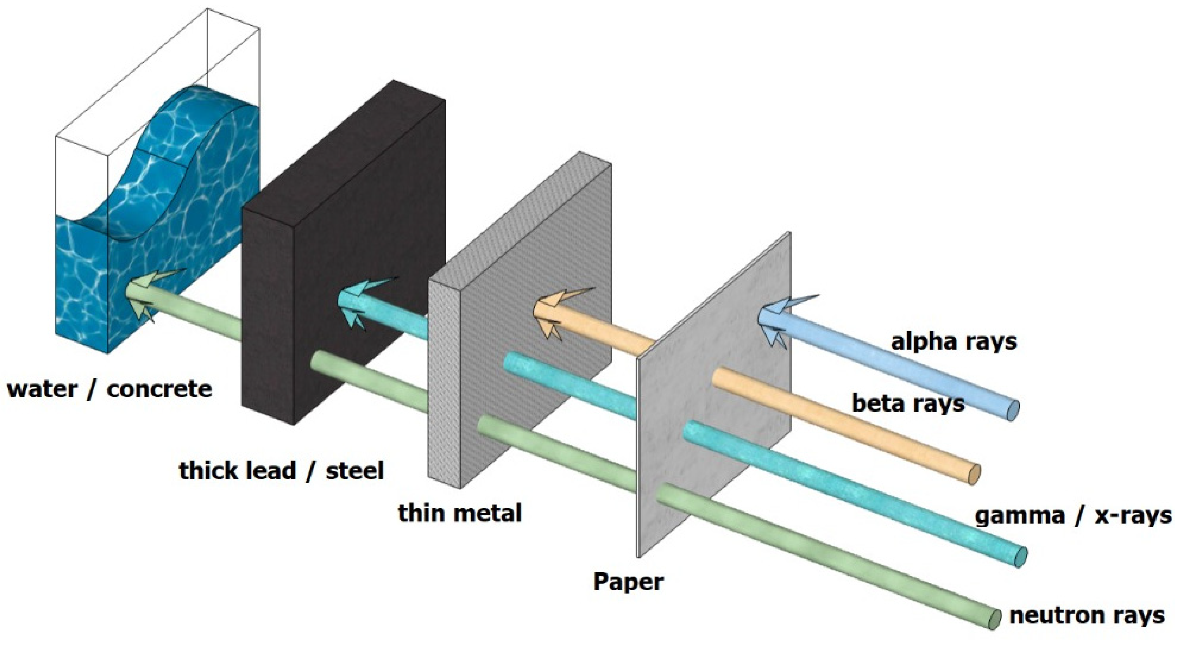
1b. Explain the ALARA principle and the measures required by law to minimize these risks. Describe what safety
requirements you will need to consider while performing the requirements in this merit badge.
ALARA – As Low As Reasonably Achievable, and is defined as performing one or any combination of the following techniques:
Shielding
Use Shielding - To shield people from a radiation source, something needs to be between the person and the radiation source. The most effective shielding will depend on what kind of radiation the source is emitting. Some radionuclides emit more than one kind of radiation.

Slide 10
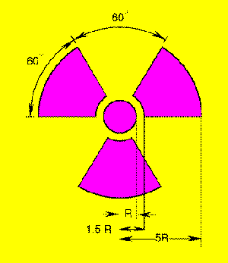
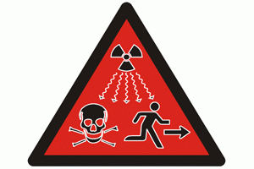
1c. Describe the radiation hazard symbol and explain where it should be used.
Yellow and Magenta Trefoil - 1948
IAEA International Symbol – 2007

Slide 11
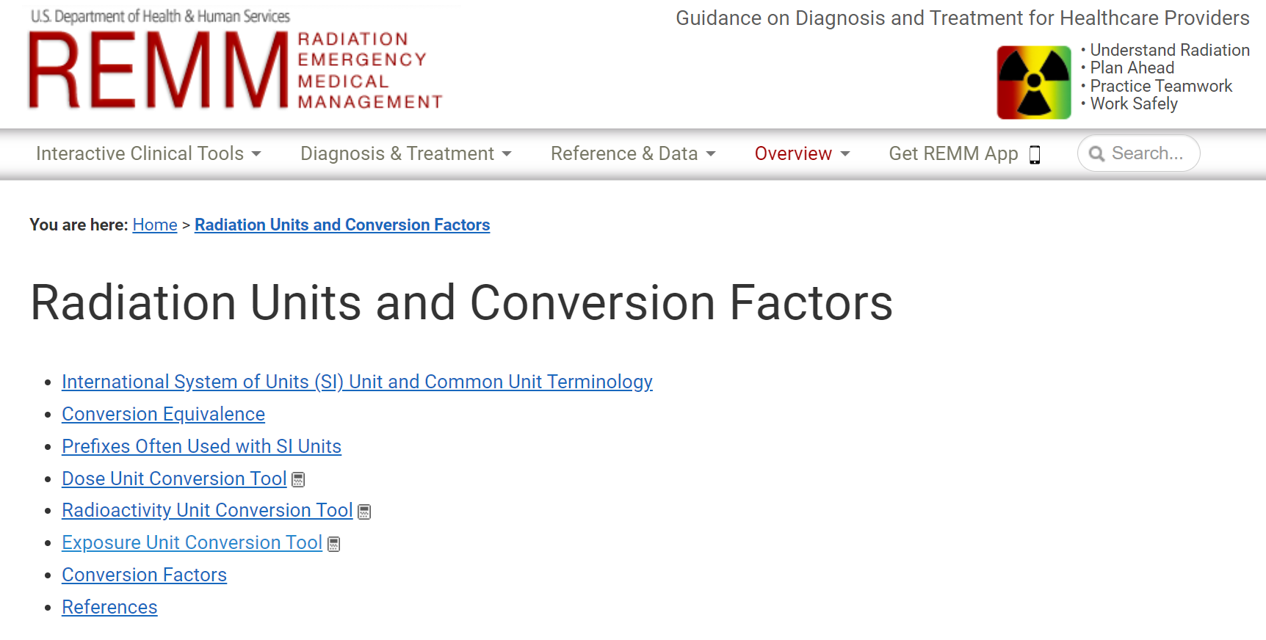
The confusing math part of Nuclear Science…
A handy conversion website: https://remm.hhs.gov/radmeasurement.htm

Slide 12
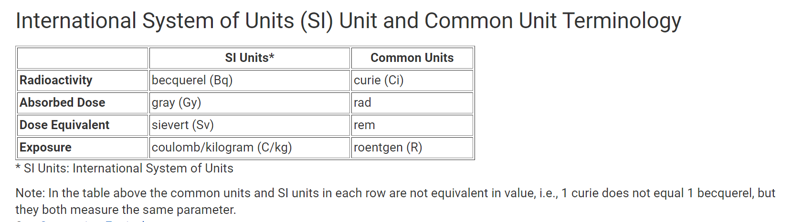
The confusing math part of Nuclear Science…
A handy conversion website: https://remm.hhs.gov/radmeasurement.htm

Slide 13
The confusing math part of Nuclear Science…
Radiation detection instruments may use roentgen for measuring gamma radiation and is written as follows:
roentgen per hour = R/h
Smaller units of measure in roentgen are measured in the following:
milliroentgen per hour = mR/h
microroentgen per hour = µR/h
The conversion of the units of measurement are as follows:
1 R/h = 1,000 mR/h = 1,000,000 µR/h
Radiation units used may vary based on the discipline (e.g., response, medical, national, or international). Responders at the incident site may use the following:
Radiation absorbed dose (rad) is a unit for measuring the amount of radiation (dose) absorbed in any material.
The roentgen equivalent man (rem) unit is the radiation energy as it relates to the dose absorbed by the human body, causing biological damage to living tissue.

Slide 14
The confusing math part of Nuclear Science…
Border states may encounter radiological measurements in the International System of Units (SI) as part of a federal response.
Gray (Gy) – The SI unit of radiation dose, expressed as absorbed energy per unit mass of tissue
Gray can be used for any type of radiation (e.g., alpha, beta, neutron, gamma), but it does not describe the biological effects of different radiations.
Sievert (Sv) – The SI unit for dose and the biological effects of radiation.
Coulombs per Kilogram (C/kg) – The SI unit for exposure that describes the amount of radiation traveling through the air
Conversion to SI units can be simple, for instance:
100 rad = 1.0 gray (Gy)
100 rem = 1.0 sievert (Sv)
https://youtu.be/EEl_Zk14z7A?si=5WxSx5iv5LR30QWJ

Slide 15
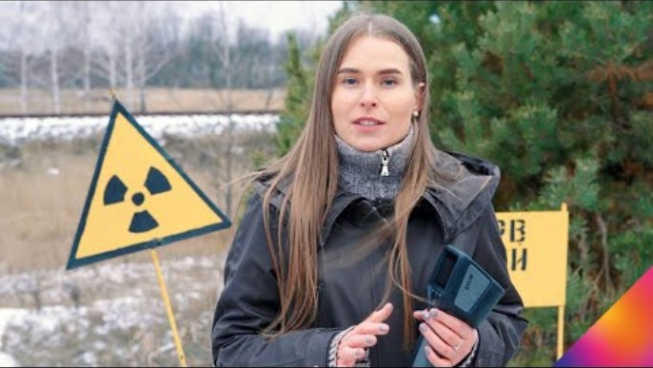

Slide 16
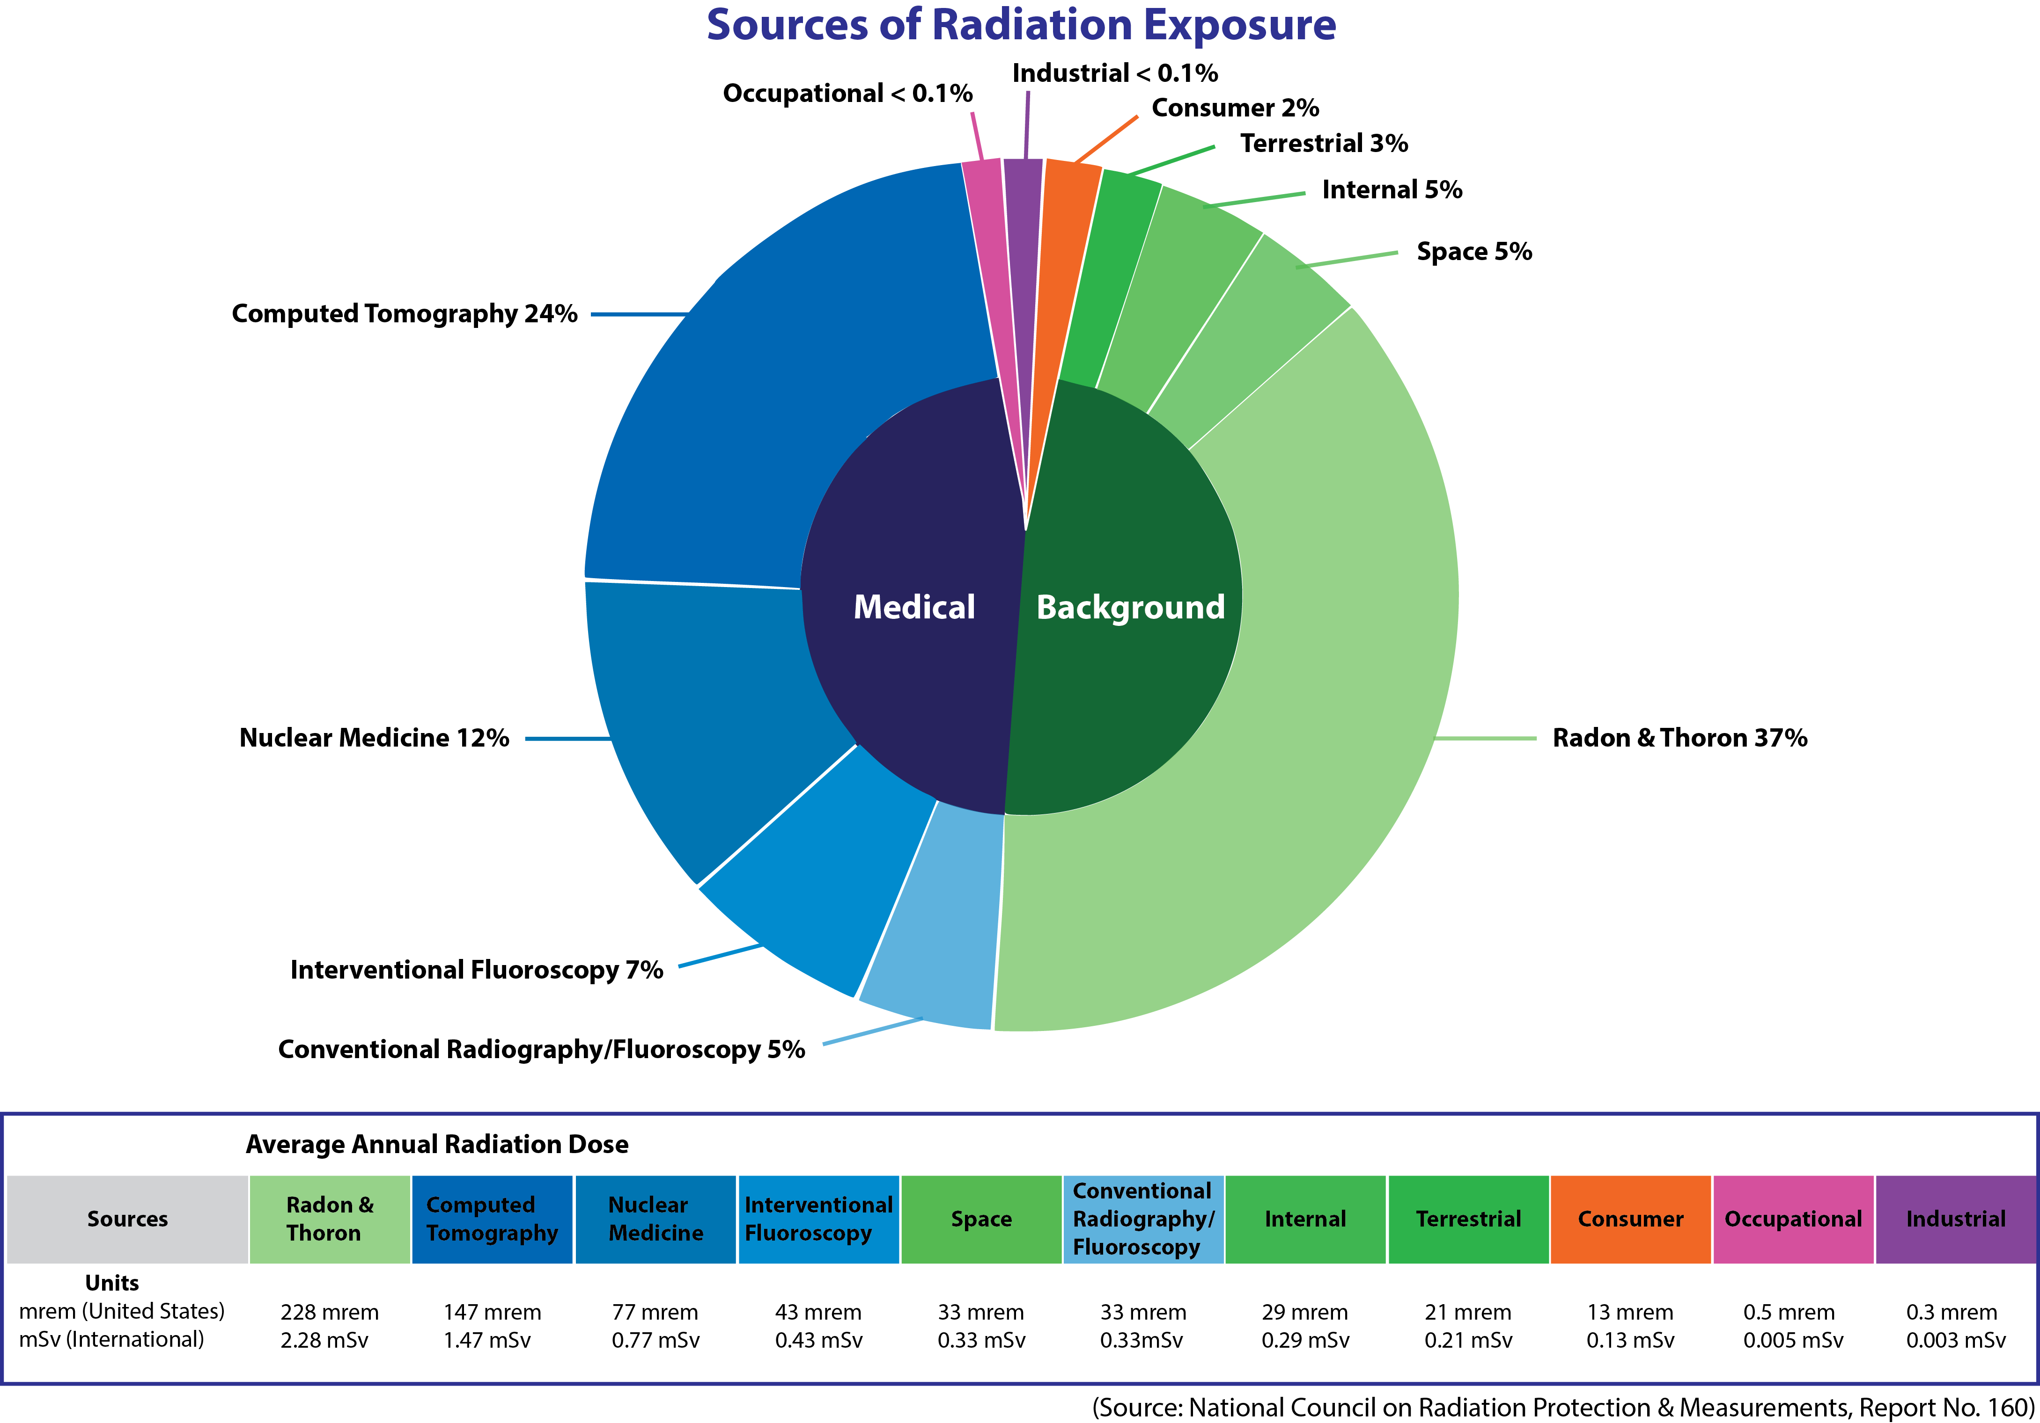
1d. Explain how we are exposed to ionizing radiation from outside the earth as well as on earth every day. List
four examples of Naturally Occurring Radioactive Materials, NORM, that are in your house or grocery store and
explain why they are radioactive.
Natural background radiation (radiation received daily) is from cosmic, terrestrial, and humanmade sources. On average, U.S. Americans receive an annual radiation dose of about 0.62 rem (620 millirem).
Half of this dose comes from natural background radiation. The remaining half comes from humanmade sources (e.g., industrial, consumer products, and nuclear medicine).

Slide 17

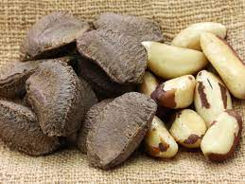
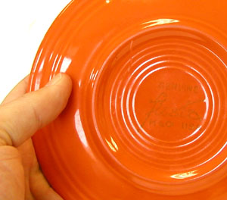
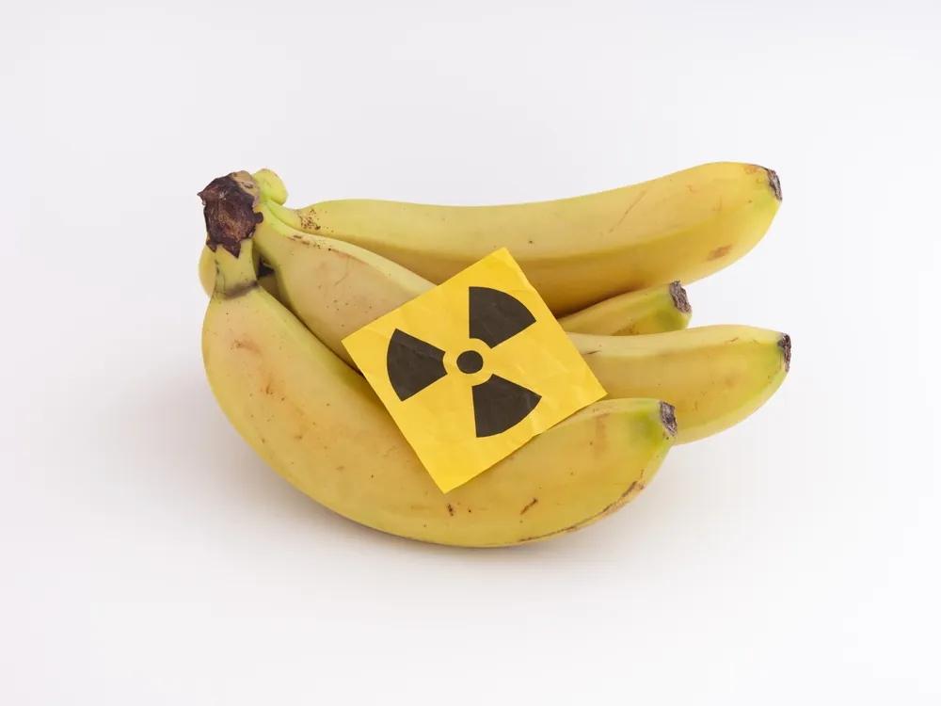

1d. Explain how we are exposed to ionizing radiation from outside the earth as well as on earth every day. List
four examples of Naturally Occurring Radioactive Materials, NORM, that are in your house or grocery store and
explain why they are radioactive.
https://www.pnnl.gov/sites/default/files/media/file/RAD_Materials_2014_PNNL-SA-103990_Rev2.pdf

Slide 18

1e. Explain the difference between radiation exposure and contamination. Describe the hazards of radiation to
humans, the environment, and wildlife. Calculate your approximate annual radiation dose and compare to that
of someone who works in a nuclear power plant.
Exposure is being close enough to a radioactive source to receive a dose of radiation, but the radioactive material is not on or in the exposed person’s body. It is radiation energy in air. (e.g. Consider X-rays at the doctor’s office; patients are exposed to radiation, but do not become contaminated.)
Exposure from an external source stops when the person leaves the area of the source, or when the source is removed from the area. Exposure can be a whole-body or partial-body exposure.
A victim of exposure to a radiological source poses no threat to those around them. (In most cases.)
Consider SL-1 reactor accident on 03 January 1961 in Idaho – Three victims where exposed to 1,000 to 1,500 Roentgens. At autopsy, the bodies of the dead men were emitting between 250 and 500 Roentgens.

Slide 19

1e. Explain the difference between radiation exposure and contamination. Describe the hazards of radiation to
humans, the environment, and wildlife. Calculate your approximate annual radiation dose and compare to that
of someone who works in a nuclear power plant.
Exposure and Contamination - The radiation hazard can either be an exposure or a contamination issue.
Contamination is radioactive material in an unwanted or uncontrolled place. Contamination may be a solid, liquid, or gas. Some types of contamination may be readily spread from one surface to another. Some contamination may be suspended in the air.
A contaminated individual will continue to be exposed until the contamination is removed.
Removal of outer clothing is the most effective first step, reducing contamination up to 90%.
Removal of the contaminant, clothing, washing, etc., also helps meet ALARA protection principles, using both the time and distance segments of the principle.

Slide 20
2a. Tell the meaning of the following: atom, nucleus, proton, neutron, electron, quark, isotope; alpha particle, beta particle, gamma ray, X-ray; ionization, radioactivity, radioisotope, and stability.
ATOM - An atom is the basic building block of chemistry. It is the smallest unit into which matter can be divided without the release of electrically charged particles. It also is the smallest unit of matter that has the characteristic properties of a chemical element.
NUCLEUS of an ATOM - The nucleus (plural, nuclei) is a positively charged region at the center of the atom. It consists of two types of subatomic particles packed tightly together. The particles are protons, which have a positive electric charge, and neutrons, which are neutral in electric charge.
PROTON - The proton is a subatomic particle with a positive electrical charge. (+) They are found in every atomic nucleus of every element. In almost every element, protons are accompanied by neutrons. The only exception is the nucleus of the simplest element, hydrogen. Hydrogen contains only a single proton and no neutrons.
ELECTRON - electrons are negatively-charged (-) and are attracted to the positively-charged protons in the nucleus. An atom is considered to be electrically neutral if it has an equal number of protons and electrons. If an atom has a different number of electrons and protons, it is called an ion.

Slide 21
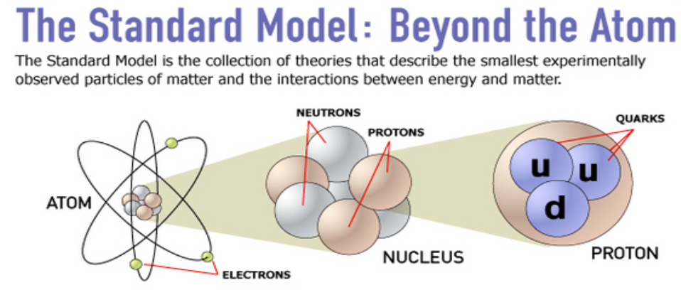
2a. Tell the meaning of the following: atom, nucleus, proton, neutron, electron, quark, isotope; alpha particle, beta particle, gamma ray, X-ray; ionization, radioactivity, radioisotope, and stability.
NEUTRON - neutral subatomic particle that, in conjunction with protons, makes up the nucleus of every atom except ordinary hydrogen (whose nucleus has one proton and no neutrons). Along with protons and electrons, it is one of the three basic particles making up atoms, the basic building blocks of all matter and chemistry. .
QUARK - A quark is an elementary particle and a fundamental constituent of matter. Quarks combine to form particles called hadrons (the most stable of which are protons and neutrons).

Slide 22
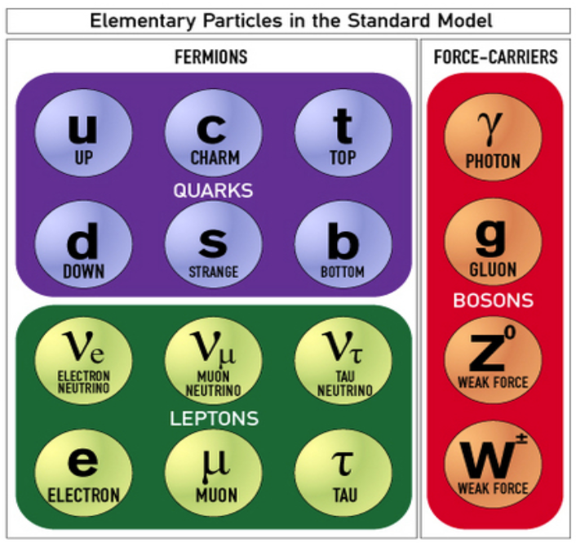
2a. Tell the meaning of the following: atom, nucleus, proton, neutron, electron, quark, isotope, alpha particle, beta particle, gamma ray, X-ray; ionization, radioactivity, radioisotope, and stability.
QUARK - A quark is an elementary particle and a fundamental constituent of matter. Quarks combine to form particles called hadrons (the most stable of which are protons and neutrons).
ISOTOPE - Isotopes are atoms with the same number of protons but differ in numbers of neutrons. Isotopes are different forms of a single element. Example - Carbon 12 and Carbon 14 are both isotopes of carbon, one with 6 neutrons and one with 8 neutrons.

Slide 23
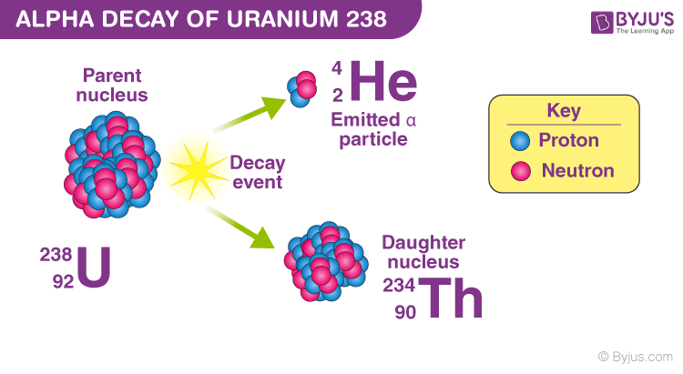
2a. Tell the meaning of the following: atom, nucleus, proton, neutron, electron, quark, isotope; alpha particle, beta particle, gamma ray, X-ray; ionization, radioactivity, radioisotope, and stability.
ALPHA PARTICLE - positively charged particle, identical to the nucleus of the helium-4 atom, spontaneously emitted by some radioactive substances, consisting of two protons and two neutrons bound together, thus having a mass of four units and a positive charge of two.

Slide 24
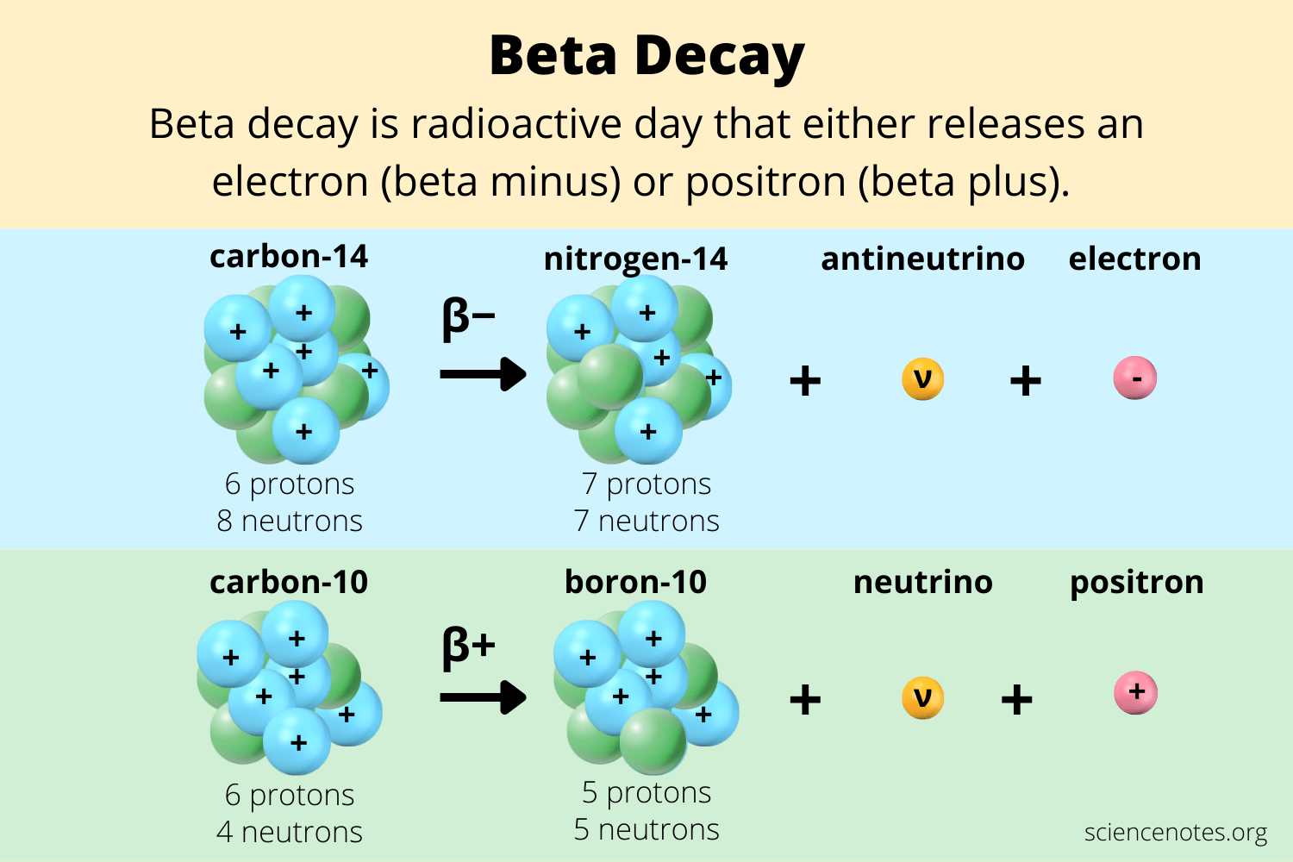
2a. Tell the meaning of the following: atom, nucleus, proton, neutron, electron, quark, isotope; alpha particle, beta particle, gamma ray, X-ray; ionization, radioactivity, radioisotope, and stability.
BETA PARTICLE - (β) are high energy, high speed electrons (β-) or positrons (β+) that are ejected from the nucleus by some radionuclides during a form of radioactive decay called beta-decay.
POSITRON is a positively charge subatomic particle that has the same mass and magnitude of charge as an electron. The positron is also called the positive electron or antielectron because it is the antimatter counterpart of the electron.

Slide 25
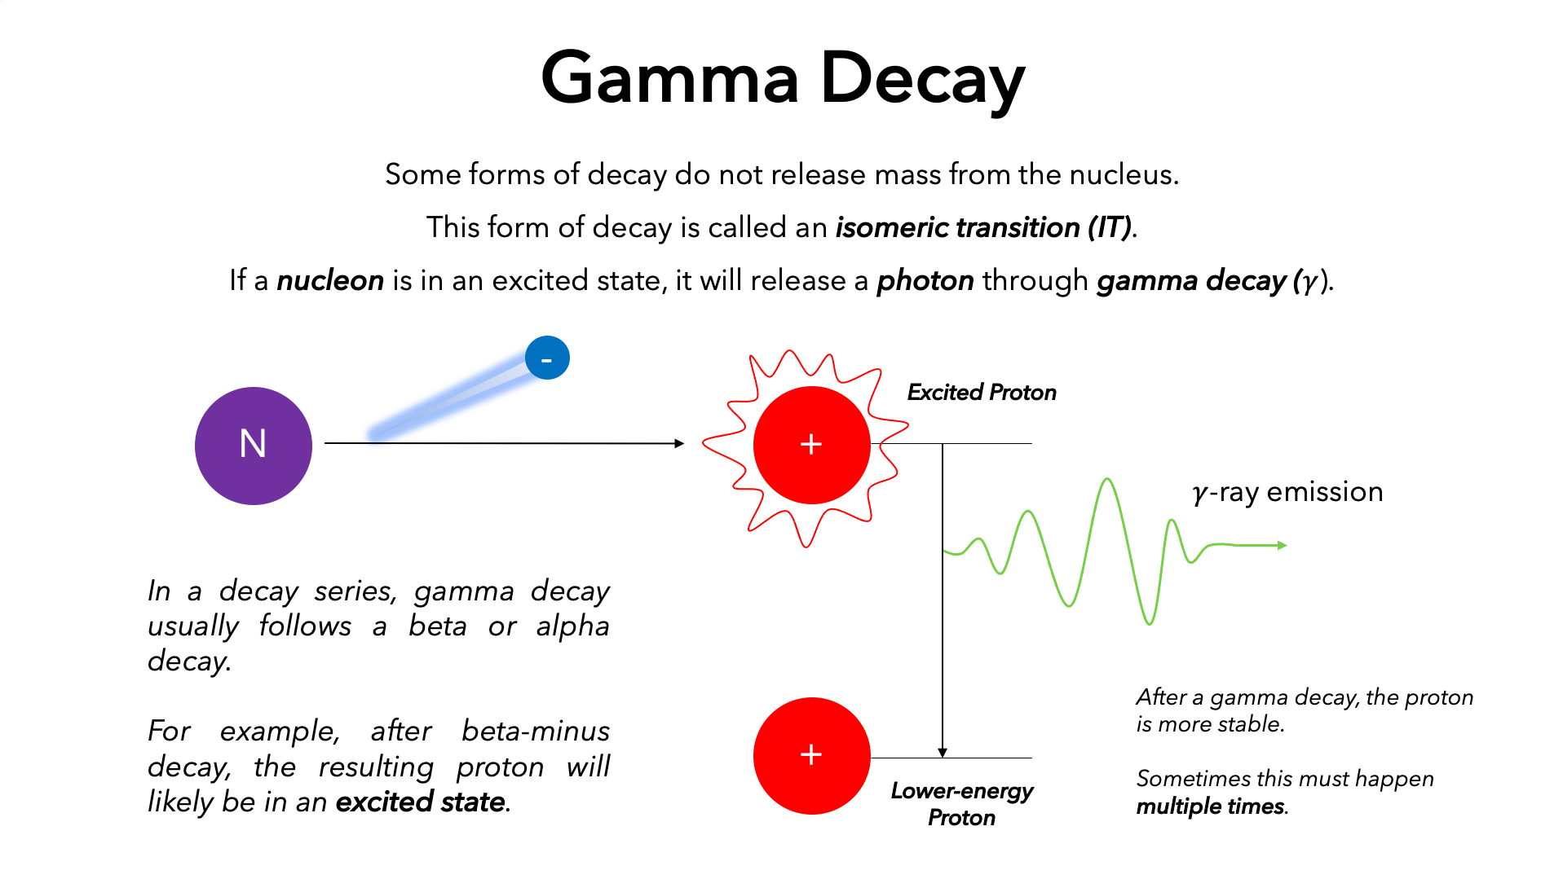
2a. Tell the meaning of the following: atom, nucleus, proton, neutron, electron, quark, isotope; alpha particle, beta particle, gamma ray, X-ray; ionization, radioactivity, radioisotope, and stability.
GAMMA RAY - Gamma rays (γ) are weightless packets of energy called photons. Unlike alpha and beta particles, which have both energy and mass, gamma rays are pure energy. Gamma rays are similar to visible light but have much higher energy. Gamma rays are often emitted along with alpha or beta particles during radioactive decay.

Slide 26
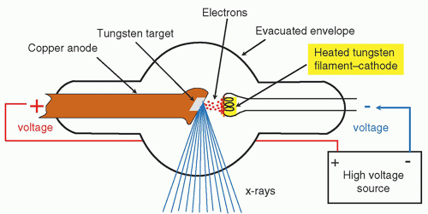
2a. Tell the meaning of the following: atom, nucleus, proton, neutron, electron, quark, isotope; alpha particle, beta particle, gamma ray, X-ray, ionization, radioactivity, radioisotope, and stability.
X-RAY - An X-ray is a packet of electromagnetic energy (photon) that originate from the electron cloud of an atom. This is generally caused by energy changes in an electron, which moves from a higher energy level to a lower one, causing the excess energy to be released.

Slide 27
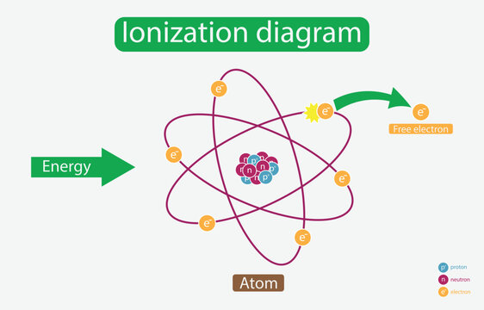
2a. Tell the meaning of the following: atom, nucleus, proton, neutron, electron, quark, isotope; alpha particle, beta particle, gamma ray, X-ray, ionization, radioactivity, radioisotope, and stability.
IONIZATION - The process in which an electron is given enough energy to break away from an atom is called ionisation. This process results in the formation of two charged particles or ions: the molecule with a net positive charge, and the free electron with a negative charge.

Slide 28
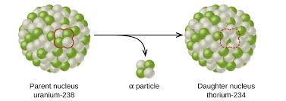
2a. Tell the meaning of the following: atom, nucleus, proton, neutron, electron, quark, isotope; alpha particle, beta particle, gamma ray, X-ray, ionization, radioactivity, radioisotope, and stability.
RADIOACTIVITY - As its name implies, radioactivity is the act of emitting radiation spontaneously. This is done by an atomic nucleus that, for some reason, is unstable; it "wants" to give up some energy to shift to a more stable configuration.

Slide 29
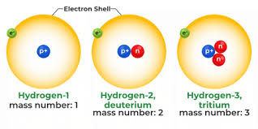
2a. Tell the meaning of the following: atom, nucleus, proton, neutron, electron, quark, isotope; alpha particle, beta particle, gamma ray, X-ray, ionization, radioactivity, radioisotope, and stability.
RADIOISOTOPE - As its name implies, radioactivity is the act of emitting radiation spontaneously. This is done by an atomic nucleus that, for some reason, is unstable; it "wants" to give up some energy to shift to a more stable configuration.

Slide 30
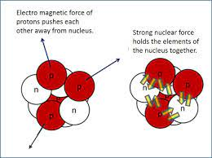
2a. Tell the meaning of the following: atom, nucleus, proton, neutron, electron, quark, isotope; alpha particle, beta particle, gamma ray, X-ray, ionization, radioactivity, radioisotope, and stability.
STABILITY- Nuclear stability means that the nucleus of an element is stable and thus it does not decay spontaneously emitting any kind of radioactivity. Among the ≈9,000 nuclei expected to exist, and the ≈3,000 presently known, only 195 are stable against spontaneous decay, because of energy conservation.

Slide 31
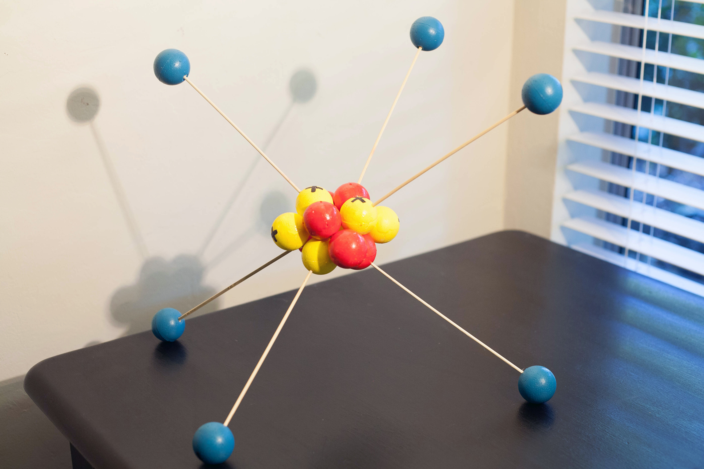

2b. Choose an element from the periodic table. Construct 3-D models for the atoms of three isotopes of this
element, showing neutrons, protons, and electrons. Write down the isotope notation for each model including
the atomic and mass numbers. In a separate model or diagram, explain or show how quarks make up protons
and neutrons.

Slide 32
3. Do ONE of the following; then discuss modern particle physics with your counselor: 3a. Visit an accelerator, research lab, or university where scientists study the properties of the nucleus or
nucleons. (If you chose this requirement, it must be completed outside of class.)
Texas A&M University at College Station - There are two nuclear research reactors that serve the Texas A&M University Nuclear Science Center. The older of the two is the AGN-201M model, a low-power teaching reactor. The newer reactor, the TRIGA Mark I, is focused strongly on research.
University of Texas at Austin – The Nuclear Engineering Teaching Laboratory at The University of Texas at Austin houses a 1.1 MW TRIGA Mark II nuclear reactor. The reactor has multiple in-core irradiation facilities and five beam ports. Currently the reactor is utilized for training, research, and service work. In 2025, The Molten Salt Research Reactor will be the first liquid-fueled molten salt reactor licensed by the U.S. Nuclear Regulatory Commission (NRC).
Abilene Christian University - a research facility designed to house a next-generation molten salt nuclear research reactor (MSRR). Named the Gayle and Max Dillard Science and Engineering Research Center (SERC), the new building is designed by Parkhill and located on the Abilene Christian University campus; it is a partnership between ACU’s NEXT Lab and Parkhill. Shorthand for Nuclear Energy eXperimental Testing Laboratory, NEXT Lab is an ACU-based research team focused on addressing the world’s demand for energy, water, and medical isotopes.

Slide 33
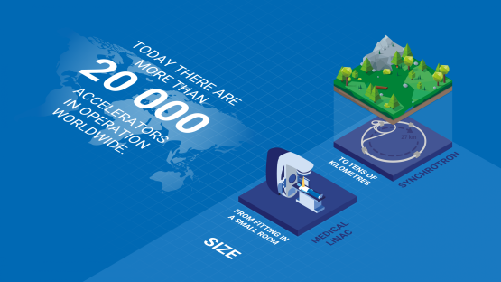
3. Do ONE of the following; then discuss modern particle physics with your counselor: 3b. List three particle accelerators and describe several experiments that each accelerator performs, including
basic science and practical applications.
Particle accelerators produce and accelerate beams of charged particles, such as electrons, protons and ions, of atomic and sub-atomic size. They are used not only in fundamental research for an improved understanding of matter, but also in plethora of socioeconomic applications related to health, environmental monitoring, food quality, energy and aerospace technologies, and others.
Particle accelerators can be linear (straight) or circular in shape and have many different sizes. They can be tens of kilometers long or fit in a small room, but all accelerators feature four principal components.

Slide 34
3. Do ONE of the following; then discuss modern particle physics with your counselor: 3b. List three particle accelerators and describe several experiments that each accelerator performs, including
basic science and practical applications.
How are particle beams used?
Health - Beams can be used to sterilize medical equipment and can produce radioisotopes required to synthesize radiopharmaceuticals for cancer diagnosis and therapy. Large accelerators are also used to destroy cancer cells, reveal the structure of proteins and viruses, and optimize vaccines and new drugs.
Research - A few accelerators — the largest ones — are used to make sub-nuclear particles collide at nearly the speed of light to advance our knowledge of the origins of our universe. Some of these accelerators are also used to produce neutrons, normally offered for diverse usage by nuclear research reactors.
Environment - Proton beams can be used to detect trace chemical elements in the air, water or soil. For example, chemicals in air samples are collected with special filters which are studied with analytical techniques. The results reveal the concentration and composition of the different pollutants and provide a unique signature of the air quality.
Industry - Beams can interact with the atoms of a target materials to make the material, for example, more durable.

Slide 35
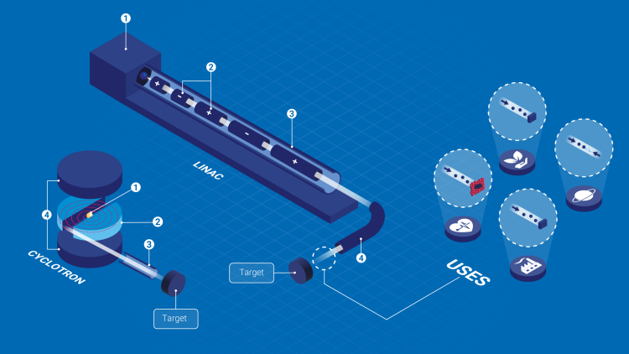
3. Do ONE of the following; then discuss modern particle physics with your counselor: 3b. List three particle accelerators and describe several experiments that each accelerator performs, including
basic science and practical applications.
A linear accelerator, also referred to as LINAC, is a machine that aims radiation at cancer tumors with pinpoint accuracy, sparing nearby healthy tissue. It's used to deliver several types of external beam radiation therapy, including Image-guided radiation therapy (IGRT)
A cyclotron is a type of particle accelerator which repeatedly propels a beam of charged particles (protons) in a circular path. Medical radioisotopes are made from non-radioactive materials (stable isotopes) which are bombarded by these protons.
(1) A source which produces the charged particles.
(2) A composite device to add energy to the particles and speed them up by applying a static or an oscillating electric field;
(3) A sequence of metallic tubes in vacuum to allow the particles to move freely in without colliding with air molecules or dust which can dissipate the beam;
(4) A system of electromagnets to steer and focus the beam particles or change their trajectories before being bombarded on a target sample.

Slide 36

3. Do ONE of the following; then discuss modern particle physics with your counselor: 3b. List three particle accelerators and describe several experiments that each accelerator performs, including
basic science and practical applications.
SLAC National Accelerator Laboratory, (https://www6.slac.stanford.edu/) originally named the Stanford Linear Accelerator Center, is a federally funded research and development center in Menlo Park, California, United States. Founded in 1962, the laboratory is now sponsored by the United States Department of Energy and administrated by Stanford University. It is the site of the Stanford Linear Accelerator, a 3.2 kilometer (2-mile) linear accelerator constructed in 1966 that could accelerate electrons to energies of 50 GeV.
Today SLAC research centers on a broad program in atomic and solid-state physics, chemistry, biology, and medicine using X-rays from synchrotron radiation and a free-electron laser as well as experimental and theoretical research in elementary particle physics, astroparticle physics, and cosmology. The laboratory is under the programmatic direction of the United States Department of Energy Office of Science.

Slide 37
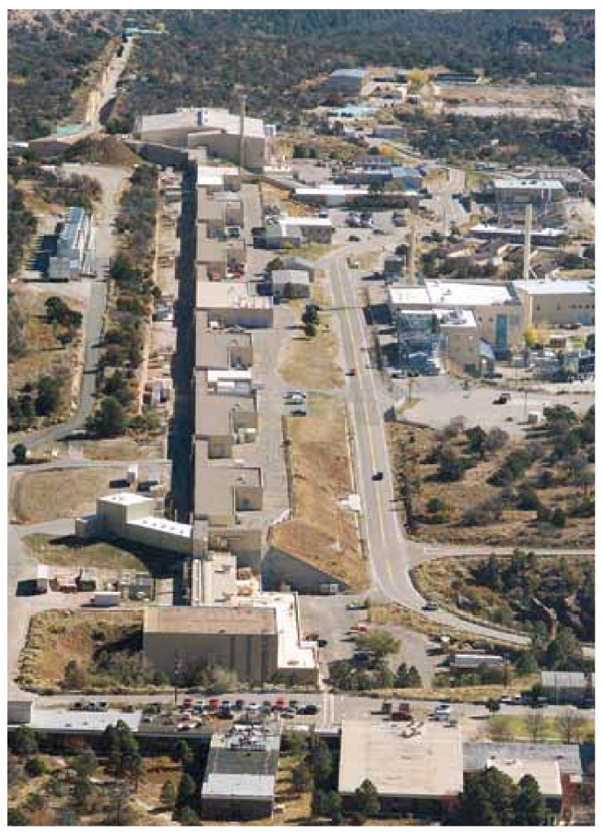
3. Do ONE of the following; then discuss modern particle physics with your counselor: 3b. List three particle accelerators and describe several experiments that each accelerator performs, including
basic science and practical applications.
The Los Alamos Neutron Science Center (LANSCE), (https://lansce.lanl.gov/) formerly known as the Los Alamos Meson Physics Facility (LAMPF), is one of the world's most powerful linear accelerators. It is located in Los Alamos National Laboratory in New Mexico in Technical Area 53. It was the most powerful linear accelerator in the world when it was opened in June 1972. The technology used in the accelerator was developed under the direction of nuclear physicist Louis Rosen. The facility is capable of accelerating protons up to 800 MeV. Multiple beamlines allow for a variety of experiments to be run at once, and the facility is used for many types of research in materials testing and neutron science. It is also used for medical radioisotope production.
LANSCE provides the scientific community with intense sources of neutrons with the capability of performing experiments supporting civilian and national security research. Agencies and programs of the Department of Energy – the National Nuclear Security Administration, the Office of Science, the Office of Nuclear Energy, and the Office of Science and Technology – have been the principal sponsors of LANSCE. LANSCE serves an international user community conducting diverse forefront basic and applied research.

Slide 38
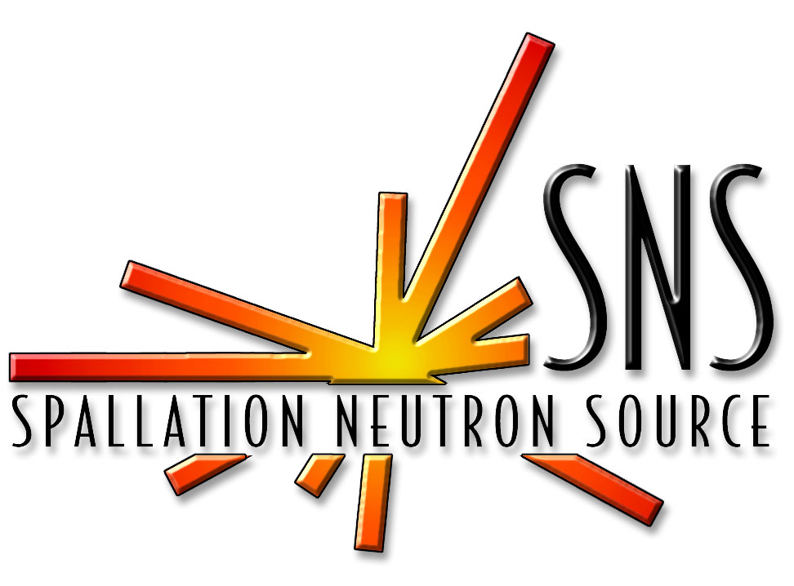
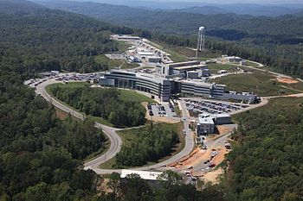
3. Do ONE of the following; then discuss modern particle physics with your counselor: 3b. List three particle accelerators and describe several experiments that each accelerator performs, including
basic science and practical applications.
The Spallation Neutron Source (SNS), (https://neutrons.ornl.gov/) is an accelerator-based neutron source facility in the U.S. that provides the most intense pulsed neutron beams in the world for scientific research and industrial development. Each year, this facility hosts hundreds of researchers from universities, national laboratories, and industry, who conduct basic and applied research and technology development using neutrons. SNS is part of Oak Ridge National Laboratory, which is managed by UT-Battelle for the United States Department of Energy (DOE). SNS is a DOE Office of Science user facility, and it is open to scientists and researchers from all over the world.
Neutron scattering allows scientists to count scattered neutrons, measure their energies and the angles at which they scatter, and map their final positions. This information can reveal the molecular and magnetic structure and behavior of materials, such as high-temperature superconductors, polymers, metals, and biological samples. In addition to studies focused on fundamental physics, neutron scattering research has applications in structural biology and biotechnology, magnetism and superconductivity, chemical and engineering materials, nanotechnology, complex fluids, and others.

Slide 39
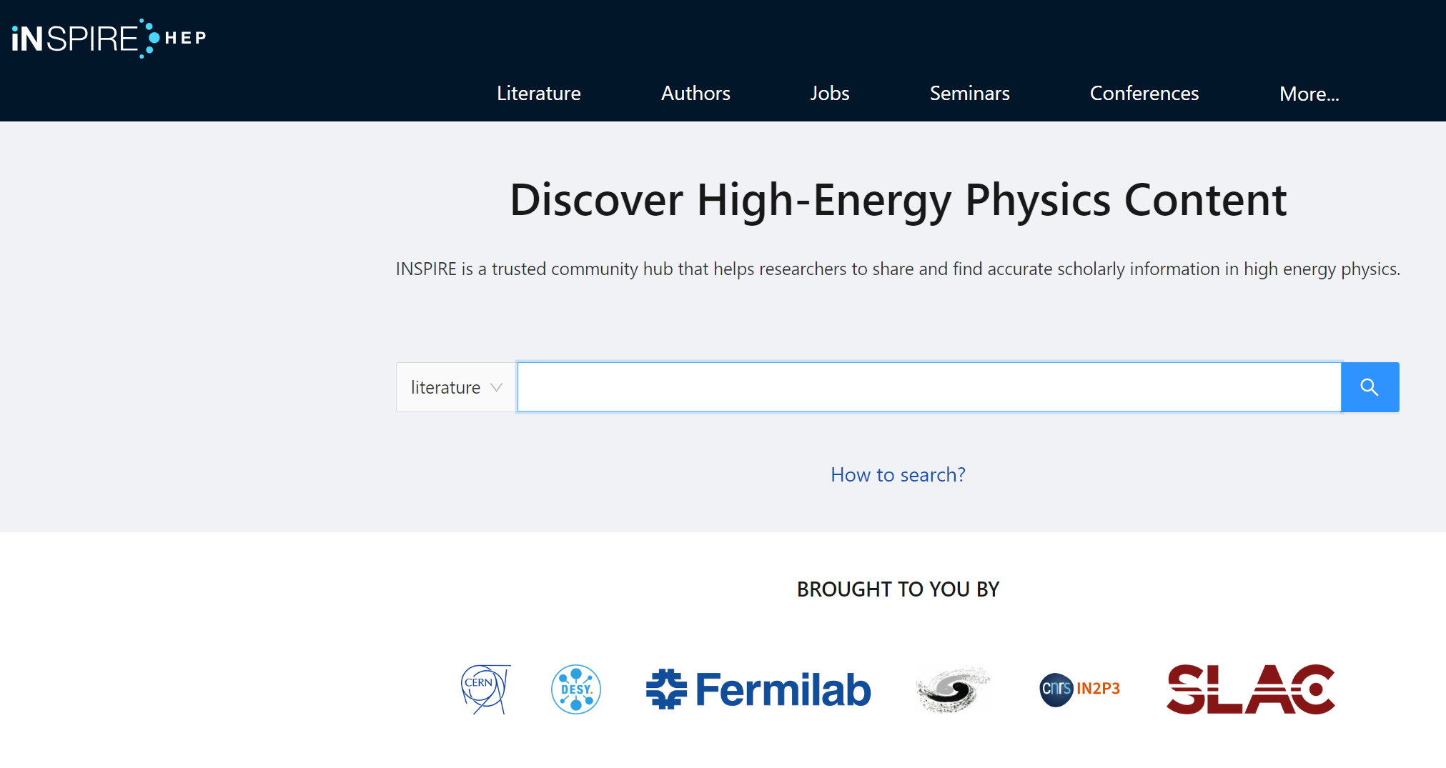
3. Do ONE of the following; then discuss modern particle physics with your counselor: 3b. List three particle accelerators and describe several experiments that each accelerator performs, including
basic science and practical applications.
INSPIRE (http://inspirehep.net/) is a trusted community hub that helps researchers to share and find accurate scholarly information in high energy physics.
It serves as a one-stop information platform for HEP community, comprising 8 interlinked databases on literature, conferences, institutions, journals, researchers, experiments, jobs and data. Run in collaboration by CERN, DESY, Fermilab, IHEP, IN2P3, and SLAC, it has been serving the scientific community for almost 50 years. Previously known as SPIRES, it was the first website outside Europe and the first database on the web. Close interaction with the user community and with arXiv, ADS, HEPData, ORCID, PDG and publishers is the backbone of INSPIRE’s evolution.

Slide 40
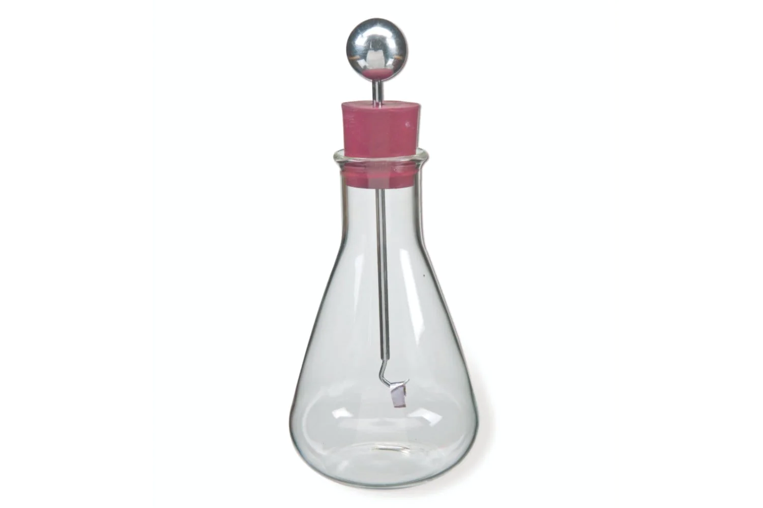
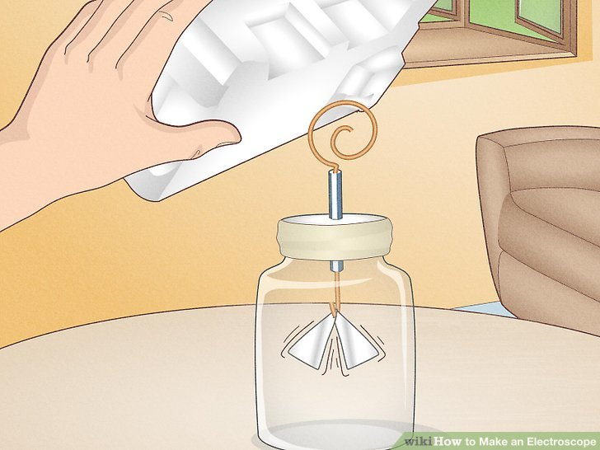
4. Do TWO of the following; then discuss with your counselor:
4a. Build an electroscope. Show how it works. Place a radiation source inside and explain the effect it causes. (If you chose this requirement, it must be completed outside of class.)
Electroscope, instrument for detecting the presence of an electric charge or of ionizing radiation, usually consisting of a pair of thin gold leaves suspended from an electrical conductor that leads to the outside of an insulating container.
The primary function of the electroscope has always been to demonstrate various electrostatic phenomena, e.g., conduction and induction of electric charges. Nevertheless, the electroscope has played a significant role in the measurement of radiation and radioactive substances.
Build your own electroscope with copper wire, aluminum foil, a plastic straw, a cardboard lid, and a glass jar. Rub a piece of styrofoam with wool to charge it with static electricity. Hold the charged styrofoam up to the coiled wire and watch the aluminum leaves separate.
https://www.wikihow.com/Make-an-Electroscope

Slide 41
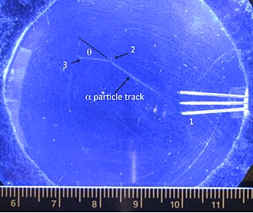
4. Do TWO of the following; then discuss with your counselor:
4b. Make a cloud chamber. Show how it can be used to see the tracks caused by radiation. Explain what is happening. (If you chose this requirement, it must be completed outside of class.)
A cloud chamber is an enclosure containing a supersaturated vapor of water or alcohol. Radiation entering the chamber causes ionization, and these ions act as condensation loci around which tiny clouds are formed because the vapors are near a point of condensation. The cloud chamber is one of the oldest particle detectors used for the observation of ionizing radiation. It was created by the Scottish physicist Charles Thomson Rees Wilson (1869-1959), who built the first fully operational cloud chamber as early as in 1911.
How to build your own cloud chamber:
https://home.cern/news/news/experiments/how-make-your-own-cloud-chamber

Slide 42
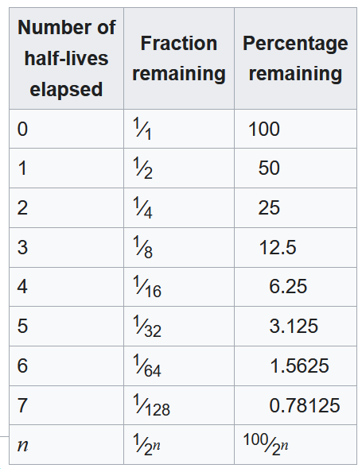
4. Do TWO of the following; then discuss with your counselor:
4c. Perform an experiment demonstrating half-life. Discuss decay chains.
Half-life (symbol t½) is the time required for a quantity (of substance) to reduce to half of its initial value. The term is commonly used in nuclear physics to describe how quickly unstable atoms undergo radioactive decay or how long stable atoms survive.
The original term, half-life period, dating to Ernest Rutherford's discovery of the principle in 1907, was shortened to half-life in the early 1950s. Rutherford applied the principle of a radioactive element's half-life in studies of age determination of rocks by measuring the decay period of radium to lead-206.

Slide 43
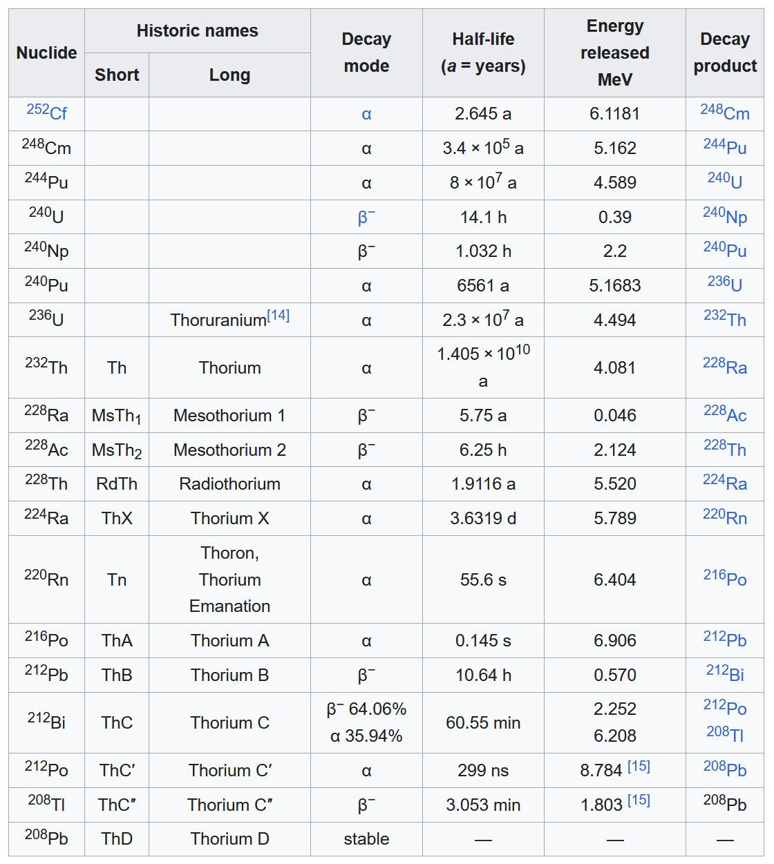
4. Do TWO of the following; then discuss with your counselor:
4c. Perform an experiment demonstrating half-life. Discuss decay chains.
In nuclear science, the decay chain refers to a series of radioactive decays of different radioactive decay products as a sequential series of transformations. It is also known as a "radioactive cascade". The typical radioisotope does not decay directly to a stable state, but rather it decays to another radioisotope. Thus, there is usually a series of decays until the atom has become a stable isotope, meaning that the nucleus of the atom has reached a stable state.

Slide 44
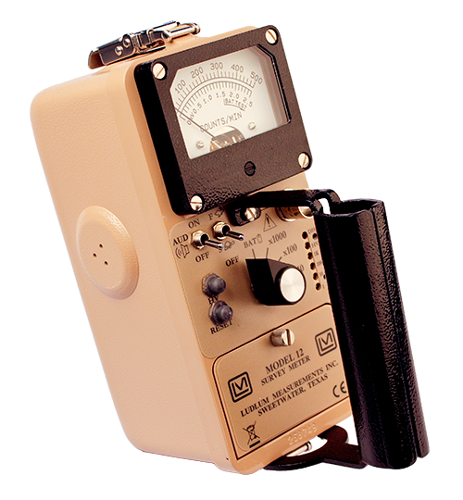
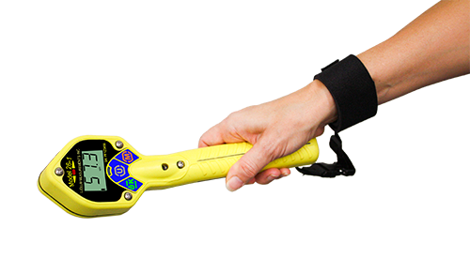
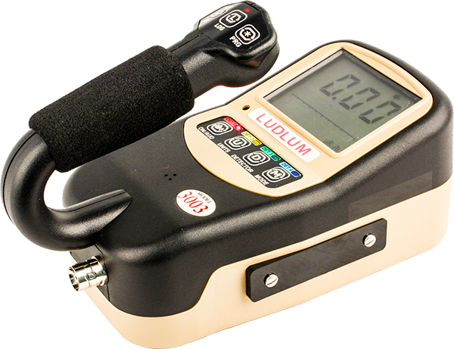
5. Do ONE of the following; then discuss with your counselor the principles of radiation safety: 5a. Using a radiation survey meter and a radioactive source, show how the counts per minute change as the source gets closer to or farther from the radiation detector. Place three different materials between the source and the detector, then explain any differences in the measurements per minute. Explain how time, distance, and shielding can reduce an individual's radiation dose.

Slide 45
6. Do ONE of the following; then discuss with your counselor how nuclear energy is used to produce electricity.
6a. Make a drawing showing how nuclear fission happens. Observe a mousetrap reactor (setup by an adult) and
use it to explain how a chain reaction could be started. Explain how a chain reaction could be stopped or
controlled in a nuclear reactor. Explain what is meant by a “critical mass.”
Nuclear fission is a reaction in which the nucleus of an atom splits into two or more smaller nuclei. The fission process often produces gamma photons and releases a very large amount of energy even by the energetic standards of radioactive decay.
Nuclear fission was discovered on 19 December 1938 in Berlin by German chemists Otto Hahn and Fritz Strassmann. Physicists Lise Meitner and her nephew Otto Robert Frisch explained it theoretically in January 1939. Frisch named the process "fission" by analogy with biological fission of living cells. In their second publication on nuclear fission in February 1939, Hahn and Strassmann predicted the existence and liberation of additional neutrons during the fission process, opening up the possibility of a nuclear chain reaction.
For heavy nuclides, it is an exothermic reaction which can release large amounts of energy both as electromagnetic radiation and as kinetic energy of the fragments (heating the bulk material where fission takes place). Like nuclear fusion, for fission to produce energy, the total binding energy of the resulting elements must be greater than that of the starting element.

Slide 46
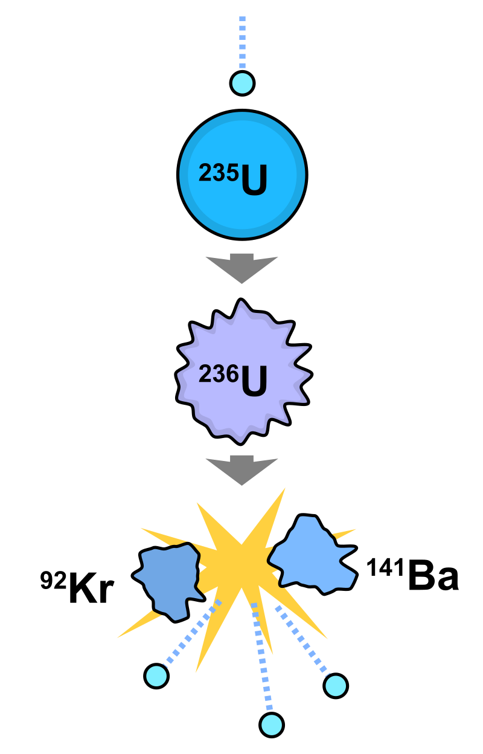
6. Do ONE of the following; then discuss with your counselor how nuclear energy is used to produce electricity.
6a. Make a drawing showing how nuclear fission happens. Observe a mousetrap reactor (setup by an adult) and
use it to explain how a chain reaction could be started. Explain how a chain reaction could be stopped or
controlled in a nuclear reactor. Explain what is meant by a “critical mass.”
Nuclear fission is a reaction in which the nucleus of an atom splits into two or more smaller nuclei. The fission process often produces gamma photons and releases a very large amount of energy even by the energetic standards of radioactive decay.

Slide 47
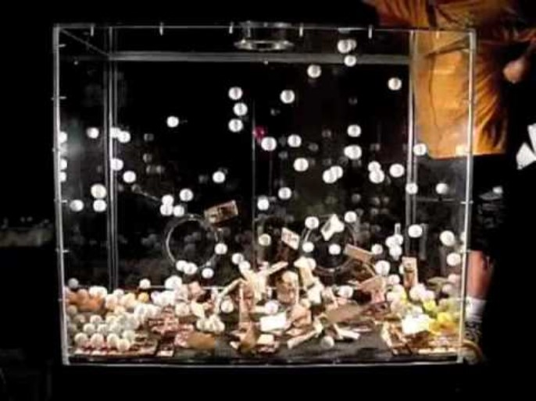
6a. Mousetrap Fission

Slide 48
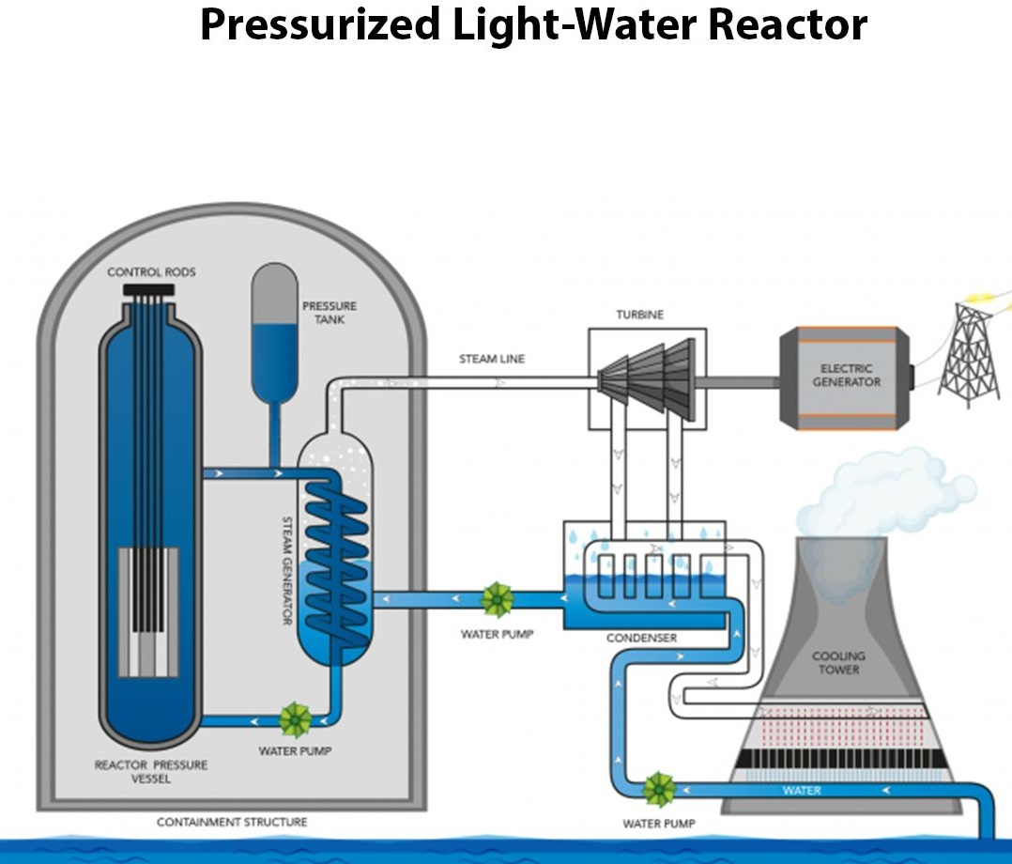
6. Do ONE of the following; then discuss with your counselor how nuclear energy is used to produce electricity.
6b. Visit a local nuclear power plant or nuclear reactor either in person or online (with your parent’s permission). Learn how a reactor works and how the plant generates electricity. Find out what percentage of electricity in the United States is generated by nuclear power plants, by coal, and by gas.
Comanche Peak Nuclear Power Plant is located in Somervell County, Texas. The nuclear power plant is located 40 miles (64 km) southwest of Ft. Worth and about 60 miles (97 km) southwest of Dallas. It relies on nearby Squaw Creek Reservoir for cooling water. Construction of the two Westinghouse pressurized water reactors began in 1974. Unit 1, originally rated at 1,084 MWe, came online on April 17, 1990. Its current, 40-year operating license is valid until February 8, 2030. Unit 2, 1,124 MWe, followed on April 6, 1993 and is licensed to operate until February 2, 2033.

Slide 49
6. Do ONE of the following; then discuss with your counselor how nuclear energy is used to produce electricity.
6b. Visit a local nuclear power plant or nuclear reactor either in person or online (with your parent’s permission). Learn how a reactor works and how the plant generates electricity. Find out what percentage of electricity in the United States is generated by nuclear power plants, by coal, and by gas.
The South Texas Project Electric Generating Station (also known as STP, STPEGS, South Texas Project), is a nuclear power station southwest of Bay City, Texas, United States. STP occupies a 12,200-acre (4,900 ha) site west of the Colorado River about 90 miles (140 km) southwest of Houston. It consists of two Westinghouse Pressurized Water Reactors and is cooled by a 7,000-acre (2,800 ha) reservoir, which eliminates the need for cooling towers. Unit 1 reached initial criticality on March 8, 1988 and went into commercial operation on August 25. Unit 2 reached initial criticality on March 12, 1989 and went into commercial operation on June 19.

Slide 50
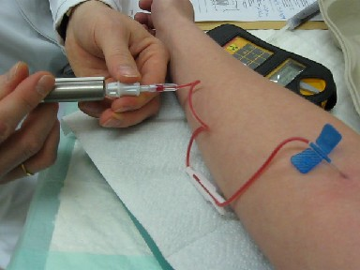
7. Give an example of each of the following in relation to how energy from an atom can be used: nuclear medicine, environmental applications, industrial applications, space exploration, and radiation therapy. For each example, explain the application and its significance to nuclear science.
Nuclear medicine uses radioactive material inside the body to see how organs or tissue are functioning (for diagnosis) or to target and destroy damaged or diseased organs or tissue (for treatment).
Nuclear medicine can show how the organs or tissues are functioning. For most diagnostic procedures, a tracer, which contains the radioactive material, is injected, swallowed, or inhaled. Then the healthcare provider or radiologist (a healthcare professional with special training to use radiation in healthcare) uses a radiation detector to see how much of the tracer is absorbed or how it reacts in the organ or tissue. This will give the provider information about how well it is functioning.

Slide 51
7. Give an example of each of the following in relation to how energy from an atom can be used: nuclear medicine, environmental applications, industrial applications, space exploration, and radiation therapy. For each example, explain the application and its significance to nuclear science.
Common uses of nuclear medicine for diagnosis include; scans of the heart, lung, kidneys, gallbladder, and thyroid.
In a type of nuclear medicine called positron emission tomography (PET), the tracer is used to show the natural activity of cells, providing more detailed information on how organs are working and if there is damage to the cells. PET scans are often combined with computed tomography (CT) scans or magnetic resonance imaging (MRI) which provide three-dimensional images of the organ.
Common uses of PET scans include; diagnosing heart disease, Alzheimer’s disease, and brain disorders and getting detailed information about cancerous tumors to decide the best treatment option
When it’s used for treatment:
When used in treatment, the tracer targets a harmful organ or tissue and radioactivity damages or stops the growth of its cells.
Two common uses of nuclear medicine for treatment include radioactive iodine therapy and brachytherapy (a form of radiation treatment where a sealed radiation source is placed inside or next to the area requiring treatment).

Slide 52
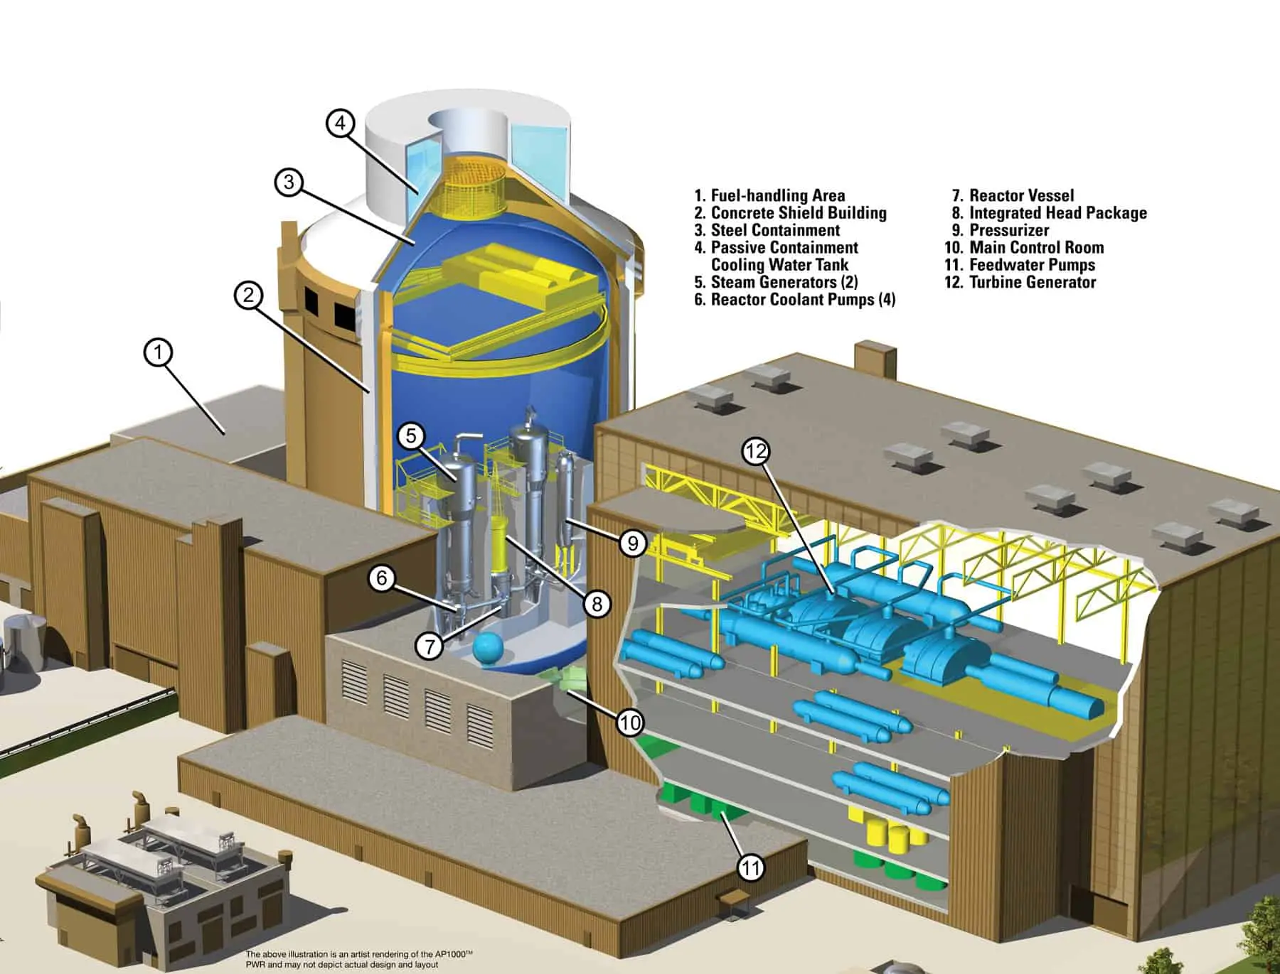
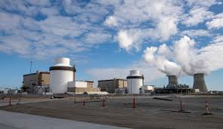
7. Give an example of each of the following in relation to how energy from an atom can be used: nuclear medicine, environmental applications, industrial applications, space exploration, and radiation therapy. For each example, explain the application and its significance to nuclear science.
Mitigating Climate Change - Climate change is one of the biggest challenges facing humanity and it’s driven — to a great extent — by carbon emissions from burning fossil fuels. Reducing and ultimately ending these emissions requires an enormous, concerted effort by governments, industry and citizens to cut our reliance on fossil fuels and transition to low-carbon energy sources such as renewables and nuclear power.

Slide 53
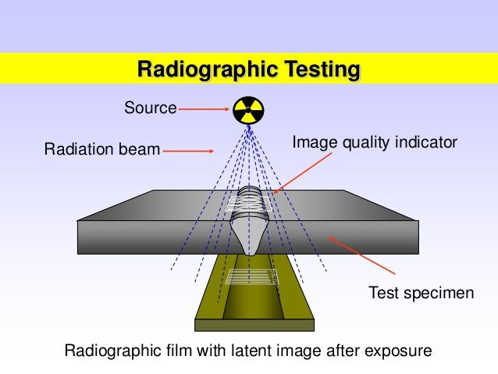
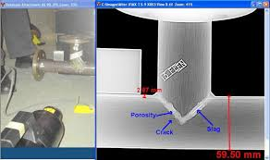
7. Give an example of each of the following in relation to how energy from an atom can be used: nuclear medicine, environmental applications, industrial applications, space exploration, and radiation therapy. For each example, explain the application and its significance to nuclear science.
Industrial radiography is a method of inspecting materials for seeing hidden flaws by using the ability of short X-rays, gamma rays and neutrons to penetrate various materials. It is a major element of non-destructive testing.
Industrial radiography for non-destructive testing is used to inspect, among others, concrete and a wide variety of welds, such as those in gas and water pipelines, storage tanks and structural elements. It can identify cracks or flaws that may not be otherwise visible. These characteristics have made non-destructive testing a key tool for quality control, safety and reliability.

Slide 54
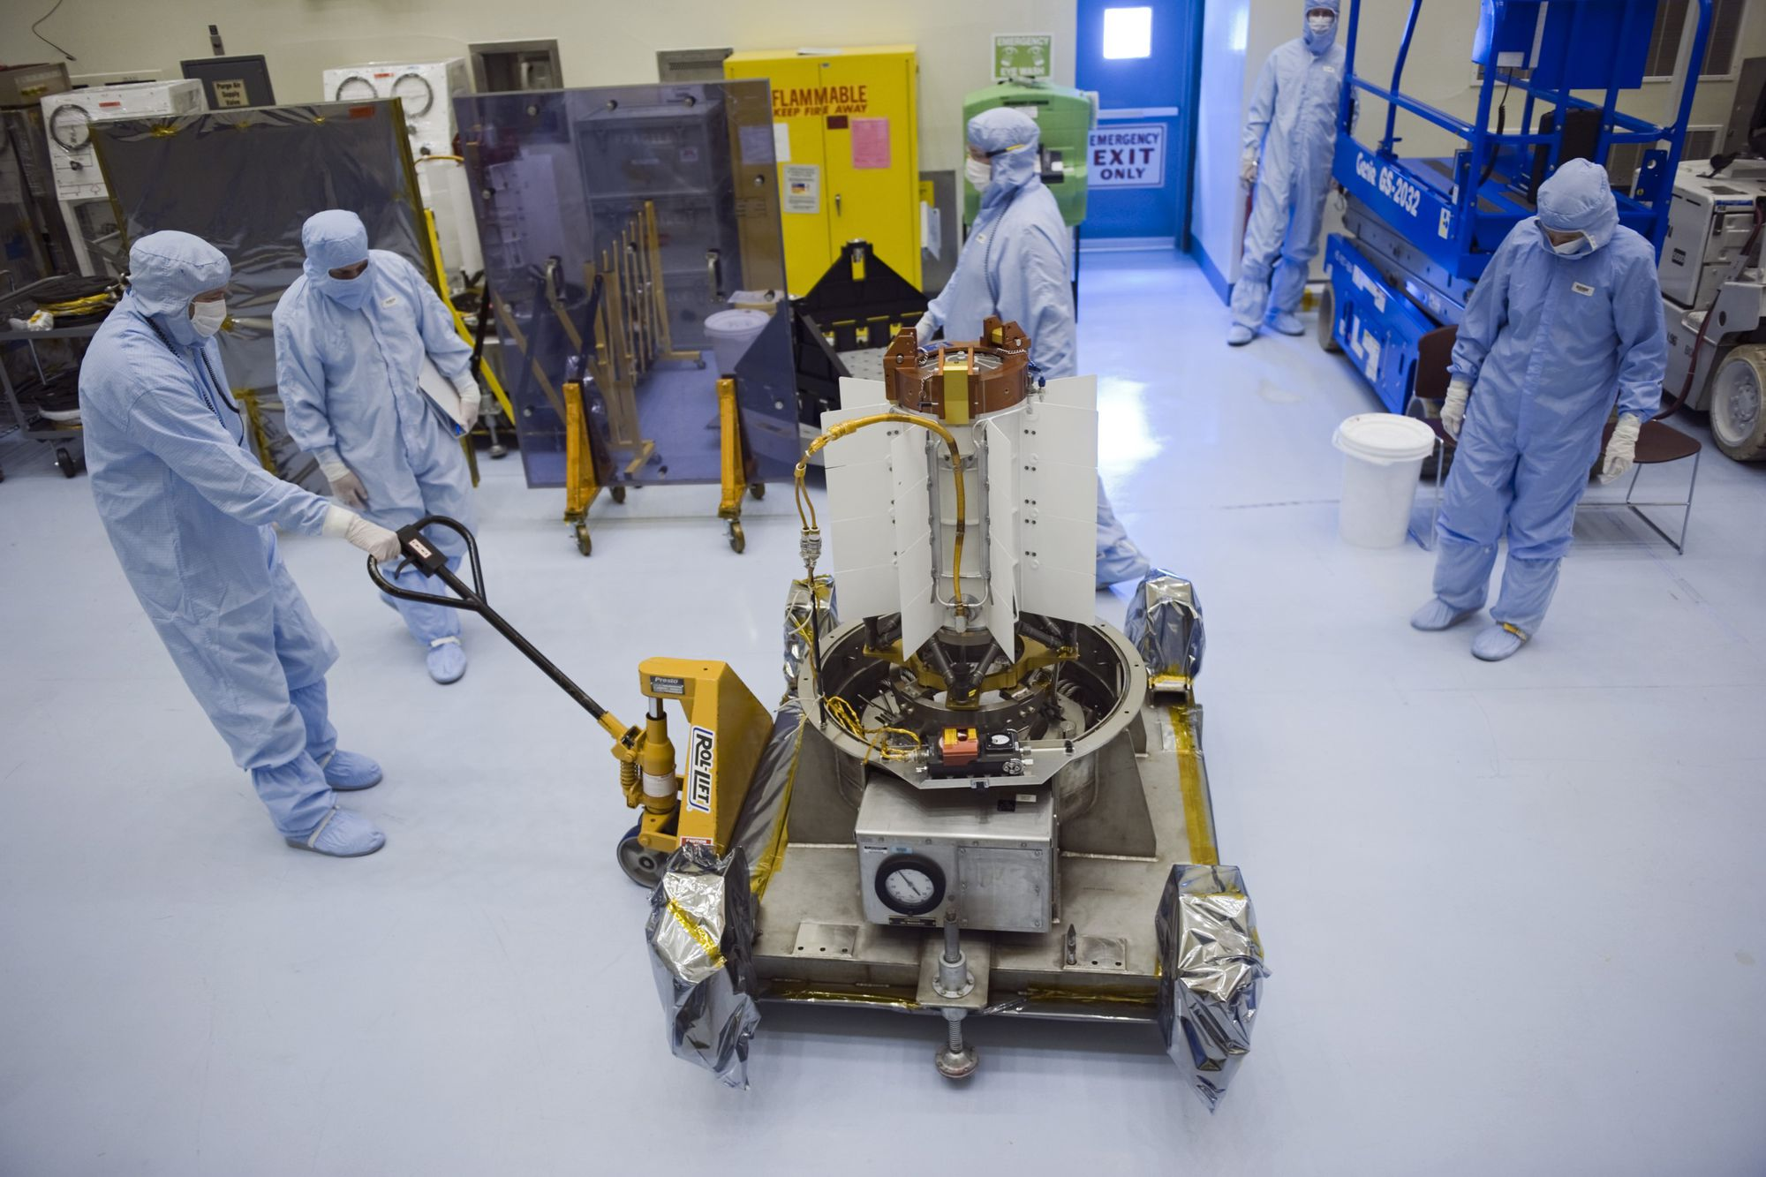

7. Give an example of each of the following in relation to how energy from an atom can be used: nuclear medicine, environmental applications, industrial applications, space exploration, and radiation therapy. For each example, explain the application and its significance to nuclear science.
Radioisotope Thermoelectric Generators (RTGs) are lightweight, compact spacecraft power systems that are extraordinarily reliable. RTGs provide electrical power using heat from the natural radioactive decay of plutonium-238, in the form of plutonium oxide. The large difference in temperature between this hot fuel and the cold environment of space is applied across special solid-state metallic junctions called thermocouples, which generates an electrical current using no moving parts.

Slide 55


7. Give an example of each of the following in relation to how energy from an atom can be used: nuclear medicine, environmental applications, industrial applications, space exploration, and radiation therapy. For each example, explain the application and its significance to nuclear science.
The Radioisotope Thermoelectric Generator (RTG) on Apollo 13 was not left on the moon as planned due to an in-flight abort. It was ejected with the Lunar Module before reentry into the earth’s atmosphere. The Lunar Module burned up in the upper atmosphere but the RTG, which was designed to survive a reentry, landed in the Tonga Trench, 6 miles below the surface.
RTG from Apollo 12 on the moon.

Slide 56

7. Give an example of each of the following in relation to how energy from an atom can be used: nuclear medicine, environmental applications, industrial applications, space exploration, and radiation therapy. For each example, explain the application and its significance to nuclear science.
Radiation therapy, also called radiotherapy, is a type of cancer treatment. This treatment uses beams of intense energy to kill cancer cells. Radiation therapy most often uses X-rays. But other types of radiation therapy exist, including proton radiation.
Modern methods of radiation are precise. They aim beams directly at the cancer while protecting healthy tissues from high doses of radiation.
Radiation therapy damages cells by destroying their genetic material. Genetic material controls how cells grow and divide.

Slide 57


7. Give an example of each of the following in relation to how energy from an atom can be used: nuclear medicine, environmental applications, industrial applications, space exploration, and radiation therapy. For each example, explain the application and its significance to nuclear science.
Radiation therapy can be given inside or outside of your body. The most common kind is external beam radiation therapy. This treatment uses a large machine called a linear accelerator. High-energy beams are aimed from the machine to a precise point on your body.
Radiation treatment that goes inside the body is called brachytherapy (brak-e-THER-uh-pee). Brachytherapy also is a common cancer treatment. During this therapy, a provider places a small solid implant in or near the cancer.

Slide 58
8. Find out about three career opportunities in nuclear science that interest you. Pick one and find out the education, training, and experience required for this profession and discuss this with your counselor. Tell why this profession interests you.
Nuclear Engineer – Bachelor’s degree, 2022 median salary $122,480/yr. or $58.89/hour. 800 new jobs per year from 2023 to 2032.
Nuclear Energy Technician – Associate’s Degree, 2022 median salary $100,420/yr. or $48.28/hour. 600 new jobs per year from 2023 to 2032.
Nuclear Weapons Engineer – Bachelor’s Degree, Average salary $105,000/yr. Limited jobs. Work at select National Labs operated by the Department of Energy and the National Nuclear Security Administration (NNSA)
Radiation Safety Technician – While a degree is preferred, 12+ college credit hours in science/physics plus 15+ college credit hours in math. Most have previous experience in a radiation field in a hospital. $72,800 to $100,000 /yr.
Health Physicist – Bachelor’s Degree, Salary Range from $90,000 to $160,000/yr. Fairly high demand.
Medical Field: X-Ray, Radiology, Cancer Therapy, Nuclear Medicine, etc. To borrow a phrase, “To be one, ask one.”
Sources: US Bureau of Labor Statistics and Zip Recruiter.

Slide 59
Sources and for more research:
ALARA – As Low As Reasonably Achievable https://www.cdc.gov/nceh/radiation/alara.html.
A Brochure for Physicians: Acute Radiation Syndrome at https://www.cdc.gov/nceh/radiation/emergencies/pdf/ars.pdf
Radiation Exposure: Diagnose and Manage Acute Radiation Syndrome (ARS) at https://remm.hhs.gov/exposureonly.htm#skip
The REMM website provides an Isotope of Interest table.
Available at https://remm.hhs.gov/isotopestable.pdf
Medical Aspects of Radiation Incidents, 4th Edition (orau.gov)
Available at https://orise.orau.gov/resources/reacts/documents/medical-aspects-of-radiation-incidents.pdf

